Slide 1
Essential Oils for Infants
Babies & Children

Slide 2
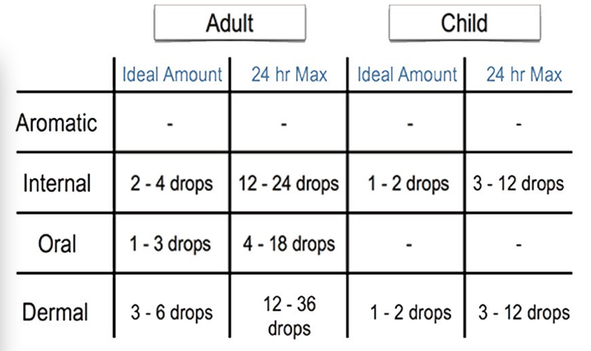

Slide 4
A to Z Chewable

Slide 5
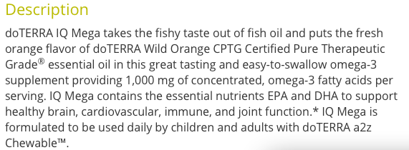
IQ MEGA

Slide 6
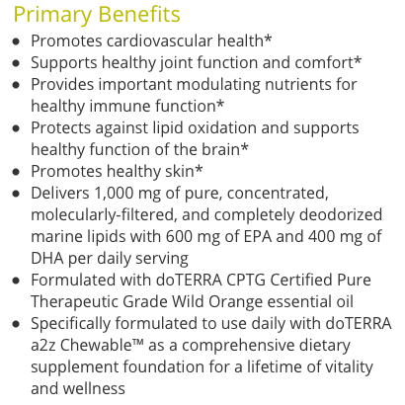

Slide 8
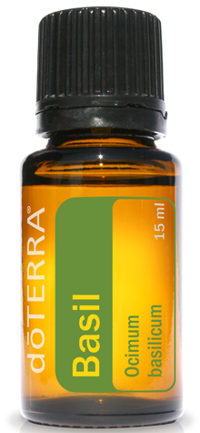
Ear Aches
Melaleuca * Lavender * Basil

Slide 9
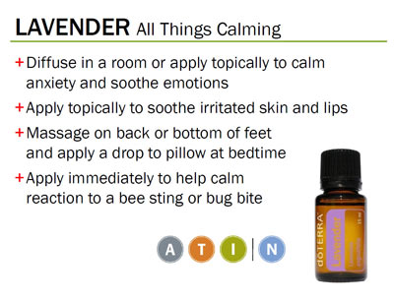

Slide 10
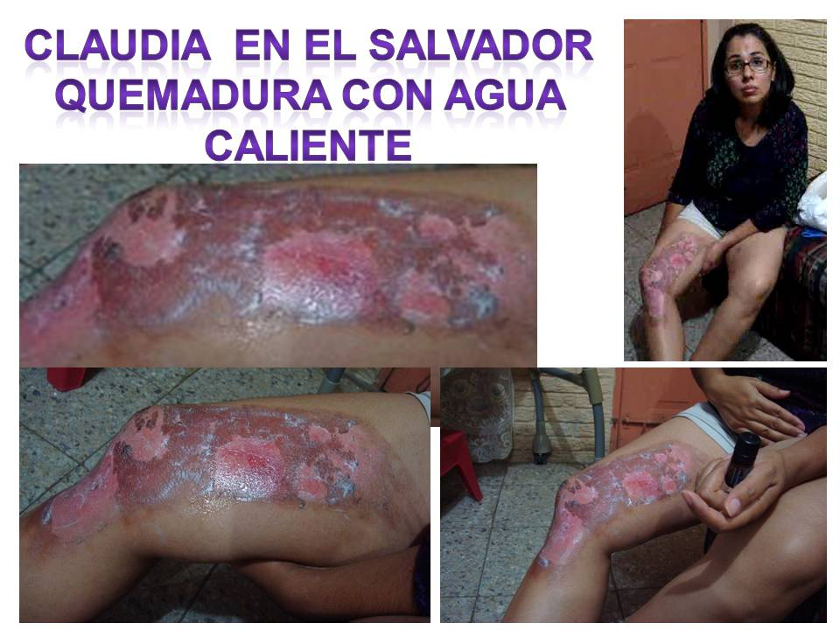
3rd Degree Burn from Boiling water

Slide 11
5 Days after applying Lavender and Melaleuca daily

Slide 12
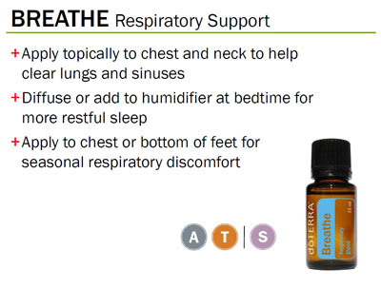

Slide 14
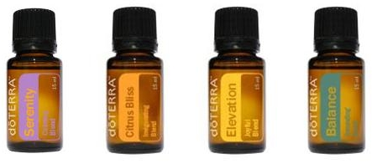
Oils that affect mood

Slide 15
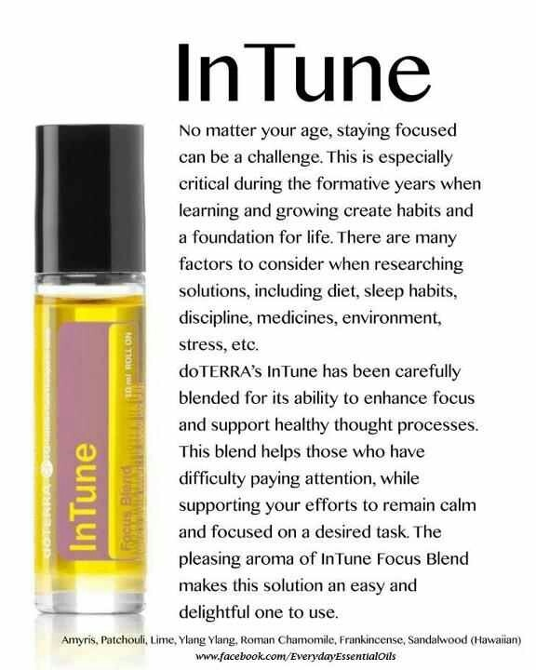

Slide 16
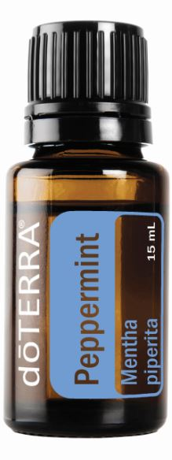
Additional oils for
Focus and attention

Slide 18
Sleepy Time
Lavender * Vetiver * Cederwood * Serenity * Peace

